Slide 1
CM 3.1: Probability Review

Slide 2
In 1990, the following question appeared in Parade Magazine’s “Ask Marilyn” column:
Suppose you’re on a game show, and you’re given the choice of three doors. Behind one door is a car, behind the others, goats. You pick a door, say #1, and the host, who knows what’s behind the doors, opens another door, say #3, which has a goat. He says to you, "Do you want to pick door #2?"
Is it to your advantage to switch your choice of doors?
Craig F. Whitaker Columbia, Maryland
Notes:
Have the students try this problem – separate out those students who KNOW and can EXPLAIN the solution.

Slide 3
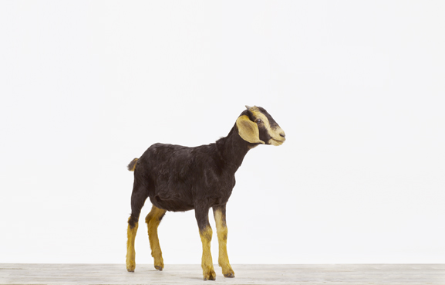
Yes; you should
Switch
-- Marilyn vos Savant
http://marilynvossavant.com/game-show-problem/

Slide 4
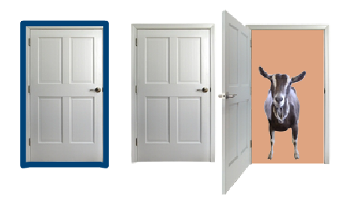
What’s the Best Strategy?
If you always switch doors after Monty Hall reveals a goat, then your odds of winning are two-in-three, or 66.7 percent on average. If you keep your original choice, your chances of winning are just one-in-three, or 33 percent on average.
That seems weird, because after Monty reveals a goat, there are two closed doors left, and it might seem as if there should be a 50-50 chance that the car is behind either door.

Slide 5
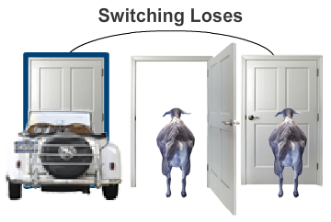
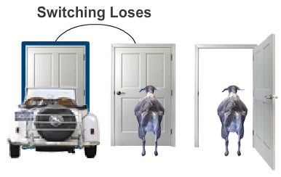
How to lose by switching
To help explain, let’s look at the situation from the other side, so we have as much information as Monty Hall does. The critical aspect of the problem is that Monty Hall always opens a door to reveal one of the goats.
If you correctly chose the door with the car at the start, he can open either of the other doors to reveal a goat. If you accept his offer to switch doors, you will switch away from your winning choice and end up with a goat. So far, switching doesn’t sound like a winning strategy.

Slide 6
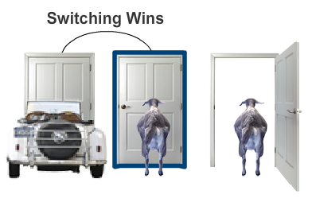
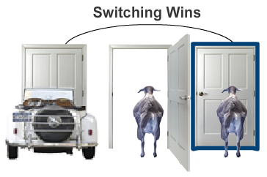
How to win by switching
But look what happens if your initial choice of door was hiding a goat. If you picked the middle door, Monty Hall opens the third door to show you a goat. In this case, if you switch doors, you switch to the door hiding the car.
The same situation applies if you chose the third door initially. (Remember, Monty Hall knows where the car is and needs to open a door that will reveal a goat.) Again, switching from your initial choice to the other closed door means you trade a goat for a car.

Slide 7
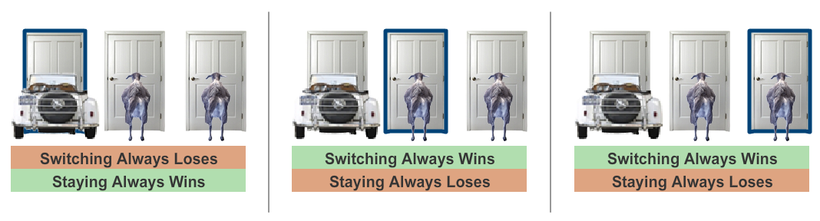
If your strategy is to always switch doors, you will lose only if your initial choice is the door with the car, which is a 33.3 percent chance. In the other two cases (66.7 percent of the time) you will switch to the car and walk away a winner.
You stay
You switch
Win 33.3%
Win 33.3%
Win 33.3%

Slide 8
“Our brains are just not
wired
to do probability problems well.”
-- Persi Diaconis
Professor of Statistics & Mathematics
Stanford University
http://www.nytimes.com/1991/07/21/us/behind-monty-hall-s-doors-puzzle-debate-and-answer.html

Slide 9
As a professional mathematician, I’m very concerned with the general public’s lack of mathematical skills. Please help by confessing your error and in the future being more careful. Robert Sachs, Ph.D. George Mason University
You made a mistake, but look at the positive side. If all those Ph.D.’s were wrong, the country would be in some very serious trouble. Everett Harman, Ph.D. U.S. Army Research Institute
May I suggest that you obtain and refer to a standard textbook on probability before you try to answer a question of this type again? Charles Reid, Ph.D. University of Florida
I am sure you will receive many letters on this topic from high school and college students. Perhaps you should keep a few addresses for help with future columns. W. Robert Smith, Ph.D. Georgia State University

Slide 10
"I wrote her another letter telling her that after removing my foot from my mouth I'm now eating
humble pie.
I vowed as penance to answer all the people who wrote to castigate me. It's been an intense professional
embarrassment."
--Dr. Robert Sachs
http://www.nytimes.com/1991/07/21/us/behind-monty-hall-s-doors-puzzle-debate-and-answer.html
Notes:
Famous theoretical physicist.

Slide 11
What is probability?
A measure of chance that something will occur.
Probability theory is the mathematical machinery necessary to answer questions about uncertain events that occur randomly.
As scientists/engineers, we need to be more precise…

Slide 12
Random Experiment:
An experiment, trial, or observation that can be repeated numerous times under the same conditions.
The outcome of an individual random experiment must be independent and identically distributed.
It must in no way be affected by any previous outcome and cannot be predicted with certainty.
http://cnx.org/content/m13470/latest/

Slide 13
Random Experiment:
Experiment is repeatable (ideally)
Outcomes are iid
Outcomes are uncertain
http://cnx.org/content/m13470/latest/

Slide 14
What does iid mean?
independent
identically
distributed
Independent:
Each sample has no relation other samples
Identically Distributed:
Each time a sample is drawn, it comes from the same underlying distribution
What it does not mean:
uncorrelated ≠ independent
“identically distributed” ≠ equally likely
Notes:
Can’t use different buckets of marbles (with different mix)
Or, lack or correlation does NOT imply independence
“However, if X and Y are uncorrelated, then they can still be dependent. To see an extreme example of this, let X be uniformly distributed on the interval [−1, 1]. If X ≤ 0, then Y = −X , while if X is positive, then Y = X . You can easily check for yourself that: • Y is uniformly distributed on [0, 1] • E[X Y|X ≤ 0] = R 0 −1 −x 2d x = −1/3 • E[X Y|X > 0] = R 1 0 x 2d x = +1/3 • E[X Y] = 0 (hint: law of total expectation). • The joint distribution of X and Y is not uniform on the rectangle [−1, 1] × [0, 1], as it would be if X and Y were independent (Figure 1). “ uncorrelated vs independent.pdf

Slide 15
(𝛀, 𝓕, 𝐏)
Probability Triple

Slide 16
The probability triple
a random experiment!!!
From Wikipedia:
“a probability triple is a mathematical construct that models a real-world process (or "experiment") consisting of states that occur randomly.”
A probability triple has (predictably) 3 parts:
𝛀 | Sample space | The set of outcomes that we are sampling from.
𝓕 | Set of events | What are the sane questions I can ask about this probability distribution?
𝐏 | Probability measure | Function that maps elements from 𝓕 to the interval [0, 1]

Slide 17
Sample space (𝛀)
The sample space is the set containing all possible outcomes from a random experiment
“What can possibly happen (in the context of the random experiment?”
Possible ≠ probable

Slide 18

Random experiment: toss a fair coin 2 times
“An idealized coin consists of a circular disk of zero thickness which, when thrown in the air and allowed to fall, will rest with either side face up ("heads" H or "tails" T) with equal probability.”
http://mathworld.wolfram.com/CoinTossing.html

Slide 19
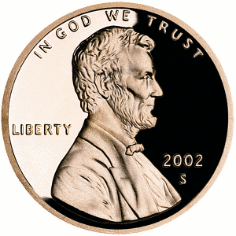

Sample space (𝛀)
“What can possibly happen?”

Slide 20


Sample space (𝛀)
“What can possibly happen?”
“What can not possibly happen?”

Slide 21
Outcomes (𝛚)
One outcome is one element in the sample space, 𝛚_{1,…n}∈𝛀
𝛚₁
𝛚₂
𝛀
𝛚₃
𝛚₄

Slide 22
Outcomes (𝛚)
𝛚
The set of all outcomes is denoted 𝛚 such that 𝛚∈𝛀
𝛚₁
𝛚₂
𝛀
𝛚₃
𝛚₄

Slide 23
(𝛀, 𝓕, 𝐏)
✓
Probability Triple

Slide 24
Events (A, B, etc.)
An event is a set of outcomes to which a probability is assigned
Notation: capital letters (i.e., A)
The actual letter means nothing
By definition, set of events is a subset of the sample space
A ⊆ 𝛀

Slide 25
Event A: same result on both flips
𝛚₁
𝛚₂
𝛀
𝛚₃
A
𝛚₄

Slide 26
Event B: exactly one head
𝛚₁
B
𝛚₂
𝛀
𝛚₃
𝛚₄

Slide 27
Event C: two heads
𝛚₁
C is an elementary event
𝛚₂
𝛀
𝛚₃
C
𝛚₄
Notes:
only a single outcome in the sample space = singleton

Slide 28
(𝛀, 𝓕, 𝐏)
✓
✓
Probability Triple

Slide 29
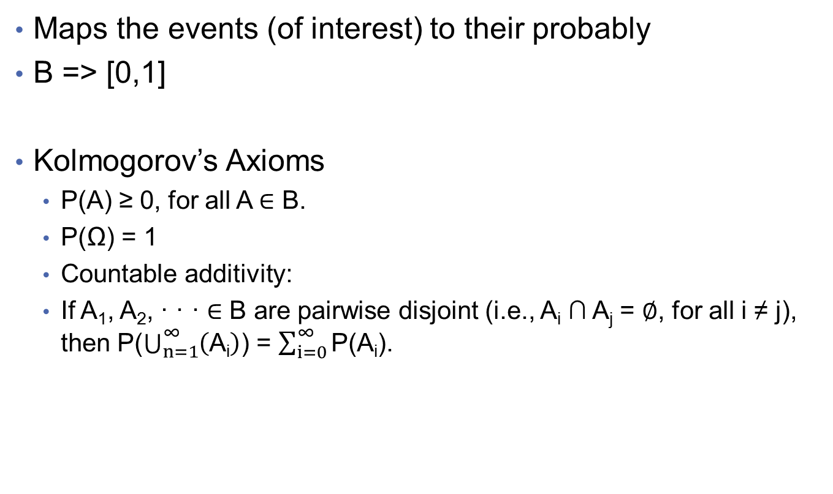
Probability Function
Maps the events (of interest) to their probably
B => [0,1]
Kolmogorov’s Axioms
P(A) ≥ 0, for all A ∈ B.
P(Ω) = 1
Countable additivity:
If A₁, A₂, · · · ∈ B are pairwise disjoint (i.e., A_{i} ∩ A_{j} = ∅, for all i ≠ j), then P($\bigcup_{n=1}^{\text{∞}}{\left(\text{A}\text{i}\right)}$) = $\sum_{i=0}^{\text{∞}}{\text{P}\text{(}\text{Ai}\text{)}}$.

Slide 30
What’s the probability function?
𝛚₁
B
𝛚₂
𝛀
𝛚₃
𝛚₄
Notes:
P(Exactly one head) = .5
P(Not exactly one head) = .5

Slide 31
Pictures are difficult to do math with…
𝛚₁
𝛚₂
𝛀
𝛚₃
𝛚₄

Slide 32
Letters are also difficult to do math with…
1st flip
f₁
2nd flip
f₂
H
T
𝛚₁ = {f₁ = H ∩ f₂ = T}
T
H
𝛚₂ = {f₁ = T ∩ f₂ = H}
𝛀
H
H
𝛚₃ = {f₁ = H ∩ f₂ = H}
T
T
𝛚₄ = {f₁ = T ∩ f₂ = T}

Slide 33
Letters are also difficult to do math with…
1st flip
f₁
2nd flip
f₂
H
T
𝛚₁ = {f₁ = H ∩ f₂ = T}
You need a function that maps outcomes and events
onto real numbers
T
H
𝛚₂ = {f₁ = T ∩ f₂ = H}
𝛀
H
H
𝛚₃ = {f₁ = H ∩ f₂ = H}
T
T
𝛚₄ = {f₁ = T ∩ f₂ = T}

Slide 34
Random variables
neither random nor variables

Slide 35
Random variable
A function that associates a real number with an event
Input: 𝛀
Output: numeric sample space
𝛀 | Sample space | The set of outcomes that we are sampling from.

Slide 36
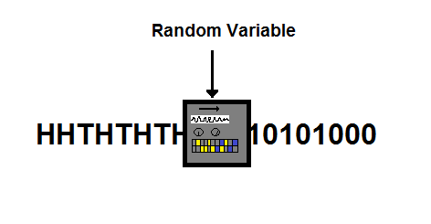
Input:
𝛚
Output:
real numbers
http://www.countbayesie.com/blog/2015/2/20/random-variables-and-expectation

Slide 37
Input:
𝛚
Output:
real numbers
2 billion, 0, 0, 2 billion
Arbitrary, nothing to do with probability yet
http://www.countbayesie.com/blog/2015/2/20/random-variables-and-expectation

Slide 38
H
T
X(𝛚₁) = 1
T
H
X(𝛚₂) = 1
𝛀
H
H
X(𝛚₃) = 2
T
T
X(𝛚₄) = 0

Slide 39
H
T
X(𝛚₁) = 1
These are x
T
H
X(𝛚₂) = 1
𝛀
H
H
X(𝛚₃) = 2
T
T
X(𝛚₄) = 0

Slide 40
Random variables: formalization
Capital letters used to denote (X, Y, Z, etc.)
Let Q = set of real numbers ℝ
Random variable (rv): X is a function X: 𝛀 →Q
Discrete rv: Q ⊆Z countable set, e.g., a subset of integers
Continuous rv: Q ⊆ ℝ is a subset of real numbers
A function f(X) of a rv is also an rv

Slide 41
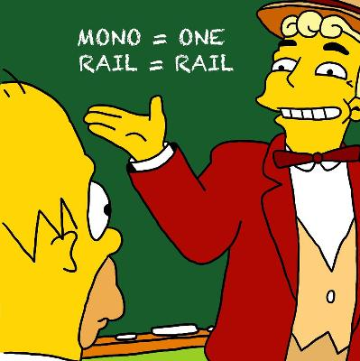
Random variables: X, Y, Z, etc.
Same letter, but in lower case, used to represent the outcomes or observed values
This is not a typo, it actually means something: X = x “the event that rv X takes on the value x”
Why call it an rv?
Random because observed value depends on outcome of random experiment
Variable because different values are possible

Slide 42
Back to probability…
Random
Variable
Probability distribution function
TTHHtHT
01001000111
½ ½ ½ ½ ½

Slide 43
Probability distribution function
Input: real numbers X(𝛚) = x
Output: always between 0 and 1
01001000111
½ ½ ½ ½ ½ ½
Output: always sum to 1

Slide 44
Simple probability
If I flip a fair penny, the probability of heads is 50%
𝑝(H) = 𝑝(T) = .5
𝛀 = {(H), (T)}
𝛚 = {(H), (T)}
X(𝛚) = 1 iff 𝛚 = H; X(𝛚) = 0 iff 𝛚 = T
P(X(𝛚) = 1) = 0.5
But what if I flip two coins?

Slide 45
Equally likely (ordered) outcomes
1st flip
f₁
2nd flip
f₂
If I flip two fair pennies, the probability of heads on each flip is still 50%
𝑝(H) =𝑝(T) = .5
All ordered outcomes here are equally likely
P(H, T) = P(H ∩ T) = .5 ⨉ .5 = ¼
P(H, T) = P(T, H) = ¼ so the probabilities are equal, but 𝛚₁ ≠𝛚₂ in the sample space 𝛀
𝛚₁
𝛚₂
𝛀
𝛚₃
𝛚₄

Slide 46
X(𝛚) ignores order, but that doesn’t mean that order does not matter when defining 𝛚∈𝛀 or P(X(𝛚))
X(𝛚)
probability
H
T
1
.25
T
H
1
.25
𝛀
H
H
2
.25
T
T
0
.25
Notes:
They remain separate events, with separate probability

Slide 47
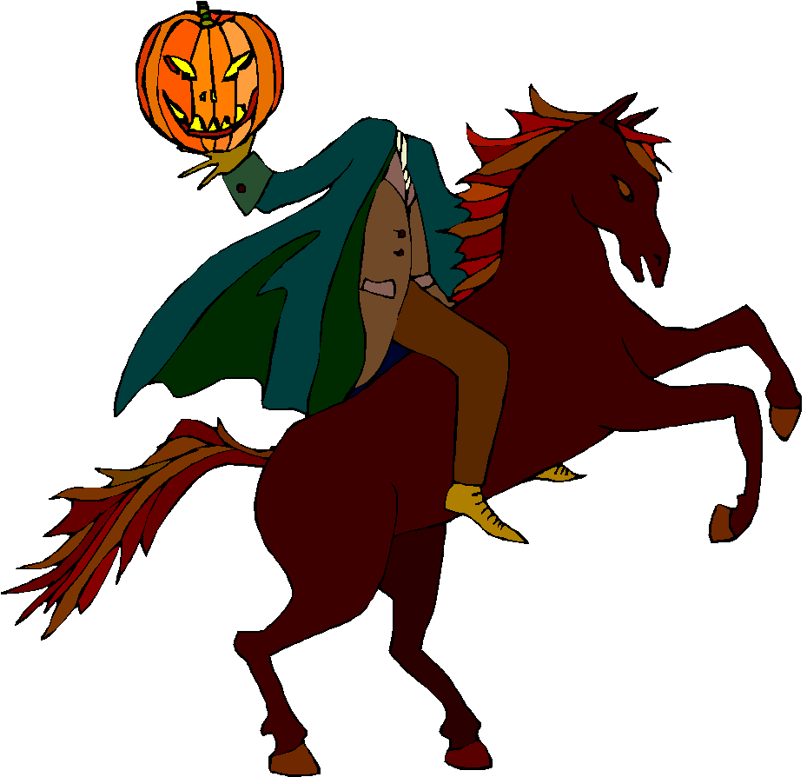
P_{X}(x)
x
P(x)
X = x
P(X = x)
equivalent
X(𝛚) = x
P(X(𝛚) = x)
H
1
.5
This notation is getting pretty cumbersome
H
H
2
.25
0
.25

Slide 48
These things are all different!
Events: e.g., a fair coin flip lands on its tail
This is an elementary event b/c refers to 1 outcome
A random variable: e.g., X
More clearly and less compactly: X(ω)
Observation of a random variable: e.g., X = 5
More clearly and less compactly: X(ω) = 5
A parameter: e.g., the probability 𝑝 of heads is ½
Distinguish between what is random but attainable
(actual data)
vs.
The unknown but ultimately important true state of nature (parameters).

Slide 49
Kolmogorov’s three axioms
Probability is a function, 𝐏, that satisfies these three conditions:
P(A) ≥ 0, for all A ⊆ 𝛀
P(𝛀) = 1
P(A∪B) = P(A) + P(B) if A∩B = 0
Any function that satisfies these three axioms is a probability function.

Slide 50
Basics
P(Aʹ) = 1 − P(A)
If A⊂B, then P(A) ≤ P(B)
P(A∪B) = P(A) + P(B) – P(A∩B)
Using set theory and our three axioms, you should be able to prove each of these.
Notes:
Draw

Slide 51
Independence
If 2 events are independent, both of these must be true:
P(A∩B) = P(A) × P(B)
P(B|A) = P(B)
Are A and B independent?
A
A∩B
𝛀
B
Notes:
Write these on the board!!

Slide 52
Independence
independent
identically
distributed
Independence of events or rvs makes it much easier to write down the probability of joint events or the joint distribution. It allows you to write these as a simple product.
Here, P(A) = ½; P(B) = ¼
P(A∩B) = P(A) × P(B) = ½ × ¼ = 1/8
A
A∩B
𝛀
B
Notes:
P(A|B) = P(A) or P(B|A) = P(B)

Slide 53
When is an event independent of itself? When is A independent of A? When is: P(A∩A) = P(A) × P(A)
Hint: P(A∩A) = P(A)

Slide 54
When is A independent of A?
P(A) = P(A ∩ A) = P(A) ⨉ P(A)
So only if P(A) = 0 or 1

Slide 55
(𝛀, 𝓕, 𝐏)
✓
✓
✓
Probability Triple

Slide 56
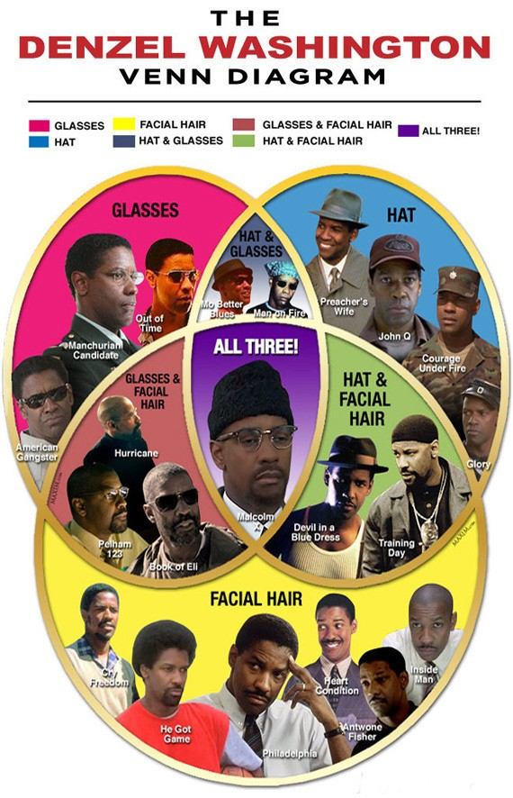
𝛀 = 21 Denzels
A = Denzel wears glasses
B = Denzel wears a hat
Are the glasses and hat events independent?

Slide 57
𝛀 = 21 Denzels
G = Denzel wears glasses
H = Denzel wears a hat
Are the glasses and hat events independent?
P(G) = 9/21 = 3/7
P(H) = 9/21 = 3/7
P(G ∩ H ) = 3/21 = .14
P(G) ⨉ P(H) = 9/49 = .18
Wearing glasses and hat together is (slightly) less likely than we’d expect if they were independent.
Notes:
Not helpful, but also woud have to be true
P(G|H) = 3/9
P(H|G) = 3/9

Slide 58
Conditional probability
The probability of an event given
that another event has occurred.

Slide 59
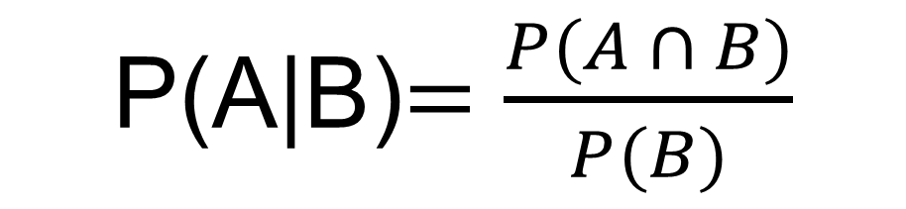
Conditional Probability
P(A|B)$=\frac{P(A ∩ B)}{P(B)}$

Slide 60
We now know that glasses and hat events are not independent.
New movie coming soon: you’ll win $1000 if you correctly guess whether Denzel’s character will have facial hair.
What do you do?

Slide 61
𝛀 = 21 Denzels
P(FH) = 12/21 = 57%

Slide 62
𝛀 = 21 Denzels
P(FH) = 12/21 = 57%
So Denzel has had facial hair in 57% of his movies- you’d be smart to guess that for a new Denzel movie, yes, he would have facial hair!

Slide 63
𝛀 = 21 Denzels
P(FH) = 12/21 = 57%
BUT: just before you enter your answer, you spy the new movie poster- Denzel has a hat on!
This is new information!
What do you do?

Slide 64

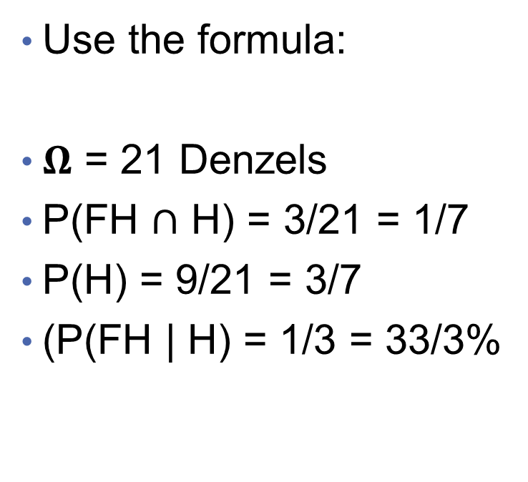
Count it out:
P(FH | H) = 3/9 = 33.3%
Use the formula:
𝛀 = 21 Denzels
P(FH $∩$ H) = 3/21 = 1/7
P(H) = 9/21 = 3/7
(P(FH | H) = 1/3 = 33/3%
P(A|B)$=\frac{P(A ∩ B)}{P(B)}$
Notes:
P(A|B) = P(A intersect B)/P(B)

Slide 65
Law of total probability

Slide 66
Law of total probability in English
If A_{i}, …A_{j} are mutually exclusive and jointly exhaustive, then the probability of B is the sum of the probabilities of B given A_{i} and conditioned on the probability of A_{i} within A.
Notes:
Draw it = square in a square

Slide 67
Bayes’ rule

Slide 68
Derive Bayes’ law

Slide 69
Bayes’ rule
From the law of total probabilities we know that P(B) can also be stated this way:

Slide 70
If you have HIV, the probability of testing positive on an HIV test is 99.9%. If you don’t have HIV, the probability of testing negative on the HIV test is 99.99%. In Oregon, about 8 people per 100,000 have HIV. Imagine you select a person at random and give them an HIV test. If the HIV test is positive, what is the probability that they have HIV?

Slide 71
Your turn
T = {test is positive}
H = {has HIV}
P(T|H) = 0.999
P(T’|H’) = 0.9999
P(H) = 0.00008 (8*10⁻⁵)
We want to solve for P(H|T)
P(T) = ?

Slide 72
Your turn
T = {test is positive}
H = {has HIV}
P(T|H) = 0.999
P(T’|H’) = 0.9999
P(H) = 0.00008 (8*10⁻⁵)
We want to solve for P(H|T)
P(T) = P(T|H) ⨉ P(H) + P(T|H’) ⨉ P(H’) = 0.999 ⨉ 0.00008 + (1 - 0.9999) ⨉ (1 - 0.00008) = 0.000179912

Slide 73
Your turn
If the HIV test is positive, what is the probability that they have HIV?

Slide 74
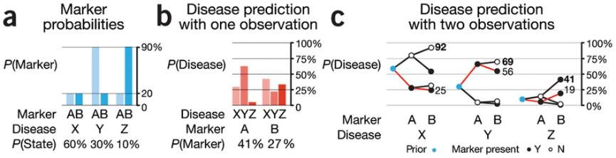
Bayes’ rule
http://www.nature.com/nmeth/journal/v12/n4/full/nmeth.3335.html

Slide 75
“Yes; you should switch.” –Marilyn vos Savant
The first door has a 1/3 chance of winning, but the second door has a 2/3 chance.
Here’s a good way to visualize what happened. Suppose there are a million doors, and you pick door #1. Then the host, who knows what’s behind the doors and will always avoid the one with the prize, opens them all except door #777,777.
You’d switch to that door pretty fast, wouldn’t you?

Slide 76
Use Bayes to solve Monty
A = {The car is behind door 1}
P(A) = 1/3; P(A’) = 2/3
B= {Monty shows you a goat behind door 2}
P(B|A) = 1/2; {He could choose either 2 or 3}
Use law of total probability to solve for P(B):
P(B) = 1/3*1/2 + 1/3*0 + 1/3*1
Assume you chose door 1:
If the car is behind door 1, Monty will chose door 2 half the time. {1/2}
If the car is behind door 2, Monty will open door 3.{0}
If the car is behind door 3, Monty will open door 2. {1}
P(A|B) =1/2*1/3 / (1/3*1/2) + (1/3*0) +(1/3*1)

